Slide 1
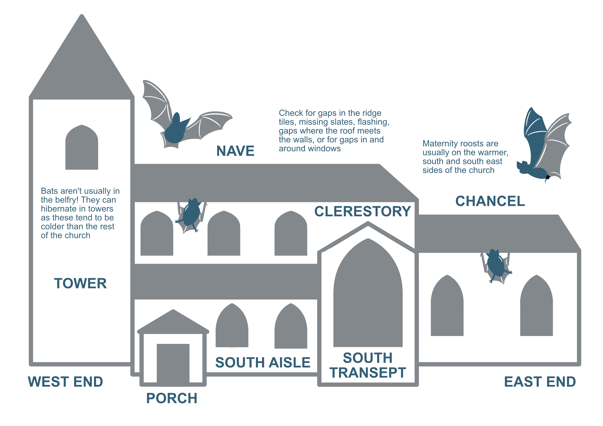


Anatomy of a church
Start the slideshow to begin the interactive presentation / quiz
Click to begin
Next >>

Slide 2
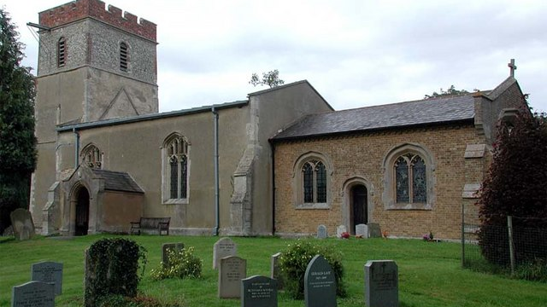
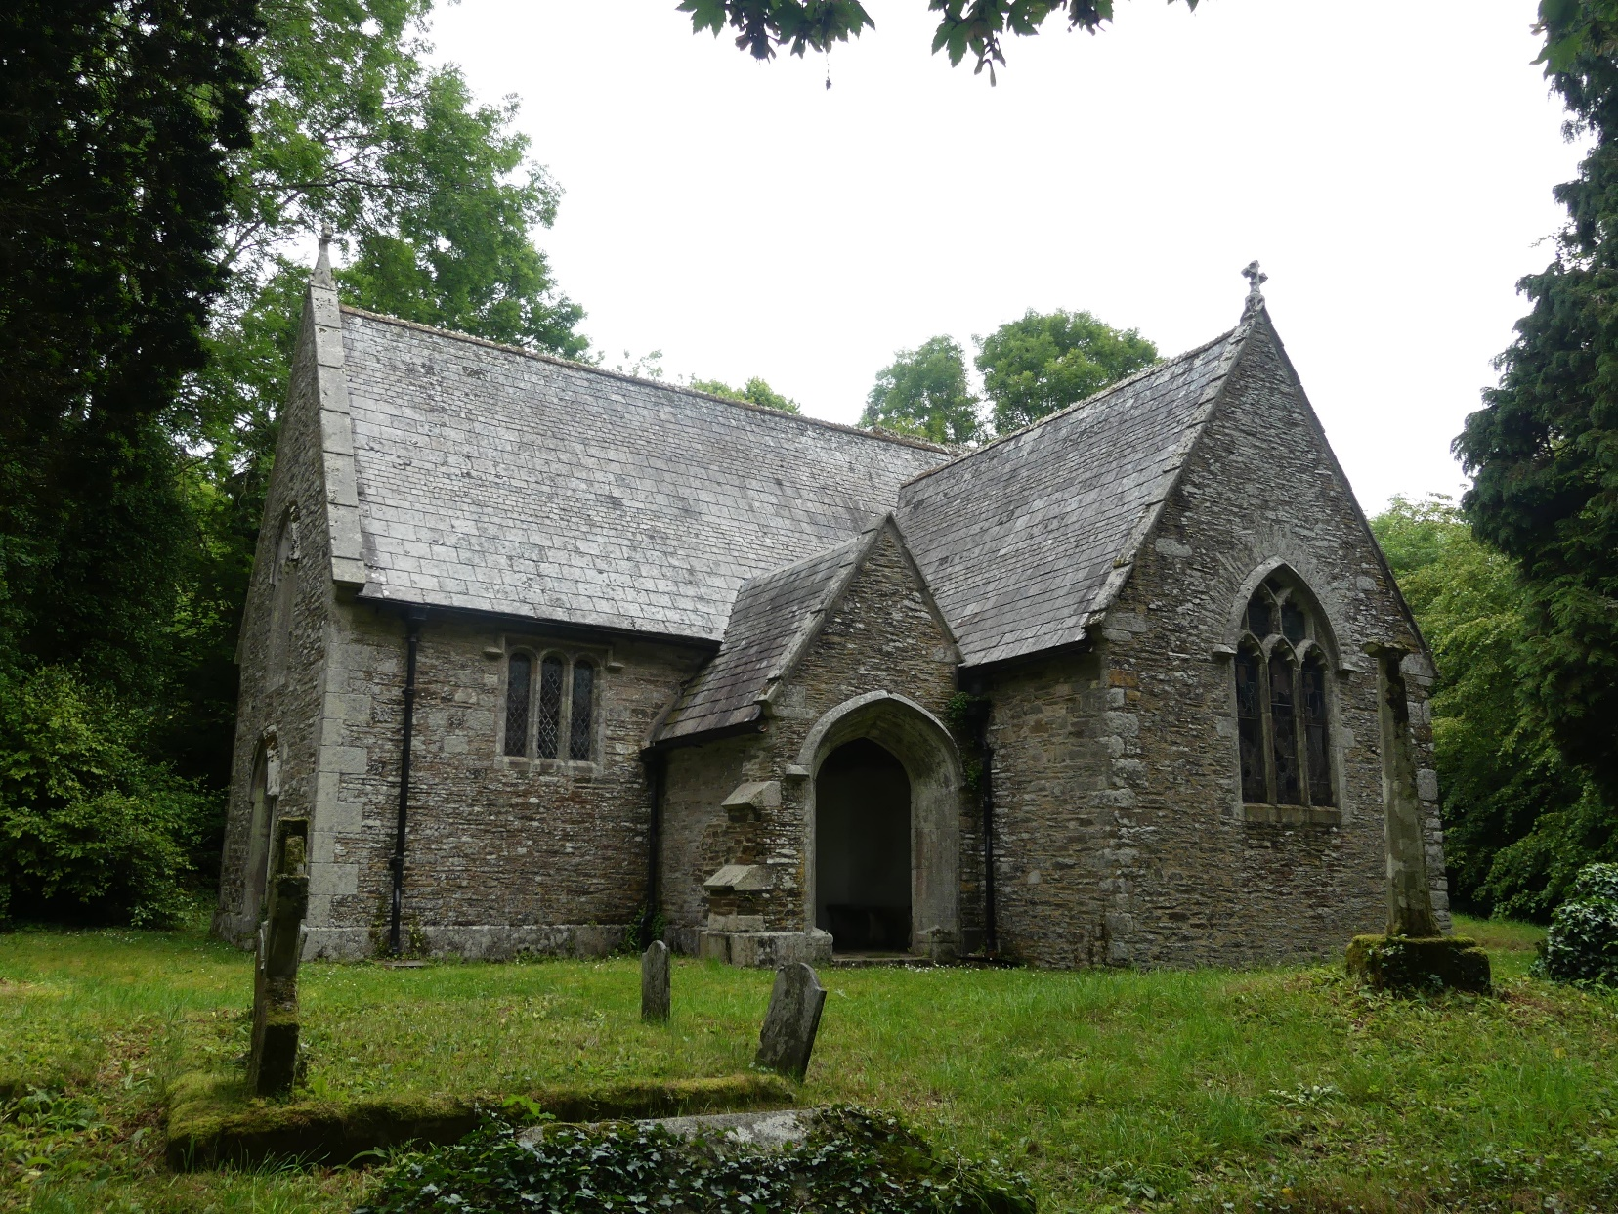
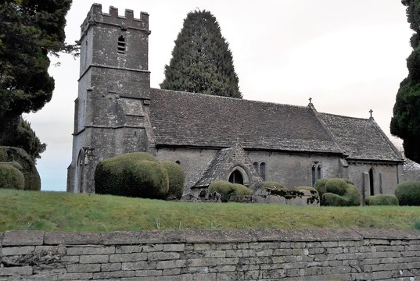
Anatomy of a church
While varying in design, most historic churches have a similar structure based on an east-to-west alignment.
Next >>

Slide 3
?
North
Click on a to find out which part of the church it is
West
East
Churches do not always have all of these elements.
The Nave is the main part of the building where the worshippers gather
South
?
Clerestory – when present admits additional light to the building
The Tower
is at the West end of the building
?
?
The Chancel
is at the East end of the building
?
?
?
Porch
South Transept
Next >>

Slide 4
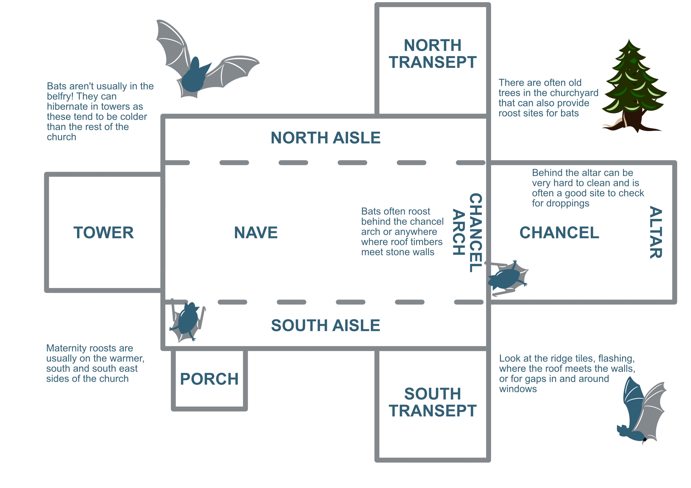
?
North
Click on a to find out which part of the church it is
?
East
West
South
?
?
?
?
?
?
?
?
?
Next >>

Slide 5
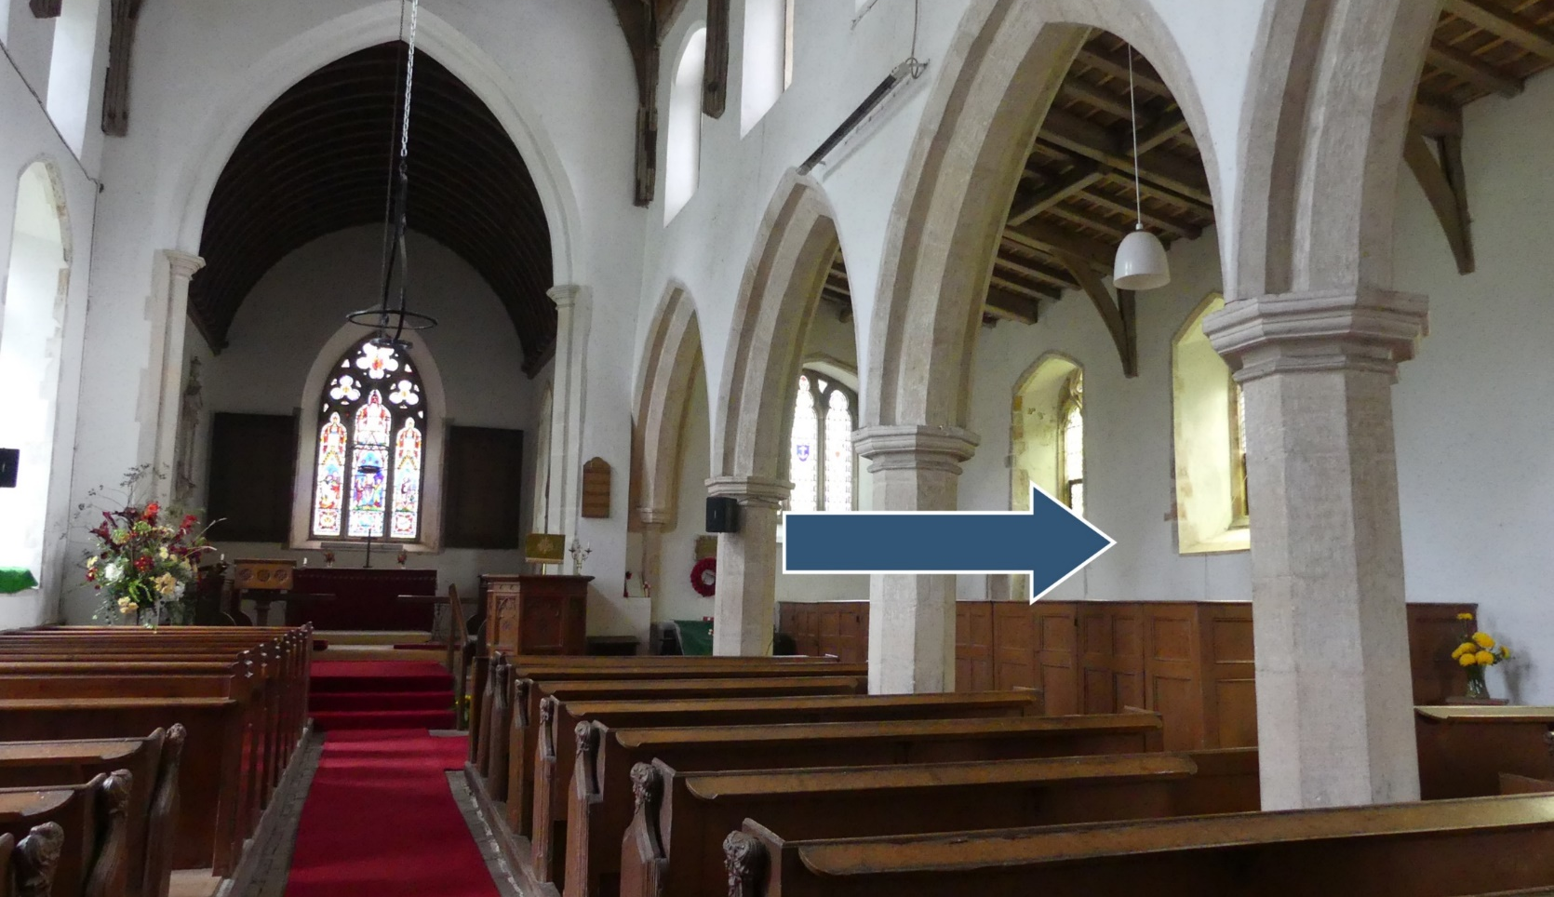

Let’s do a little quiz
Click on the name of the area the arrow is pointing to
a) South transept
b) South aisle
Perfect!
c) North aisle
Next >>

Slide 6
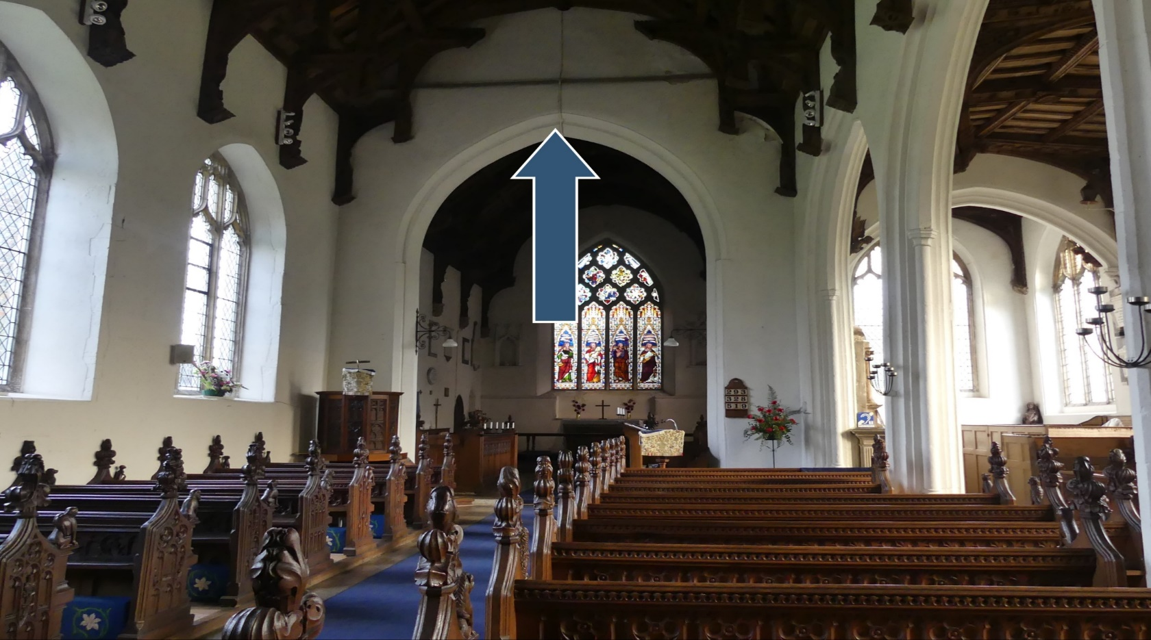
Click on the name of the area the arrow is pointing to
a) Chancel arch
Great!
b) Nave arch
c) Clerestory
Next >>

Slide 7
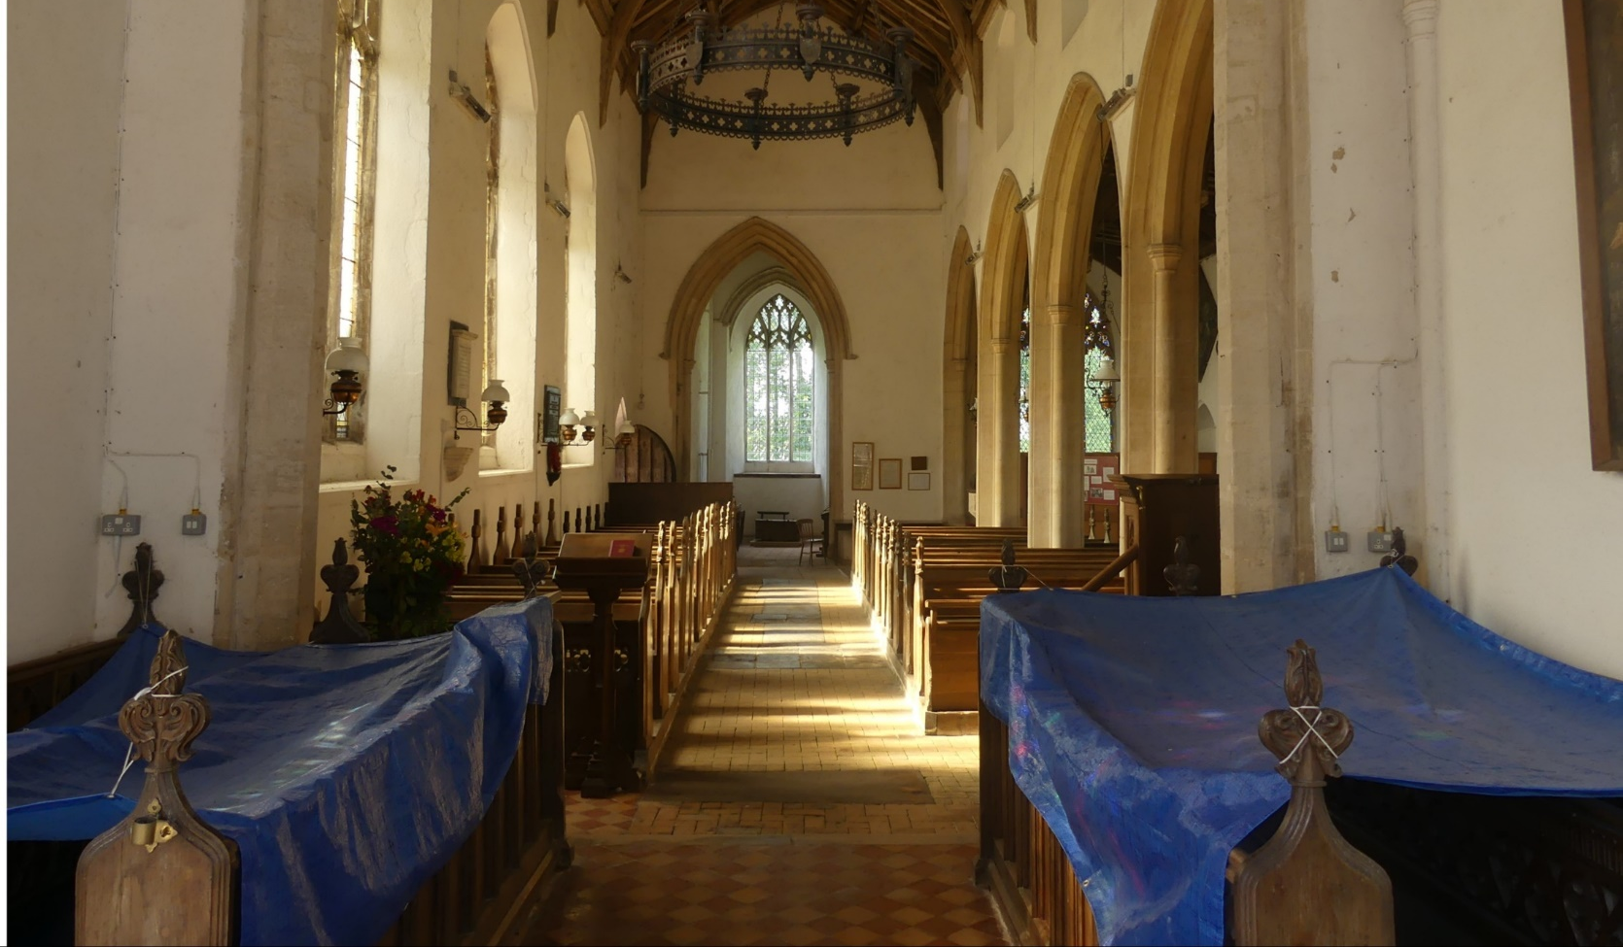
Where is the photographer standing?
a) South transept
b) Porch
c) Chancel
Great!
Next >>

Slide 8
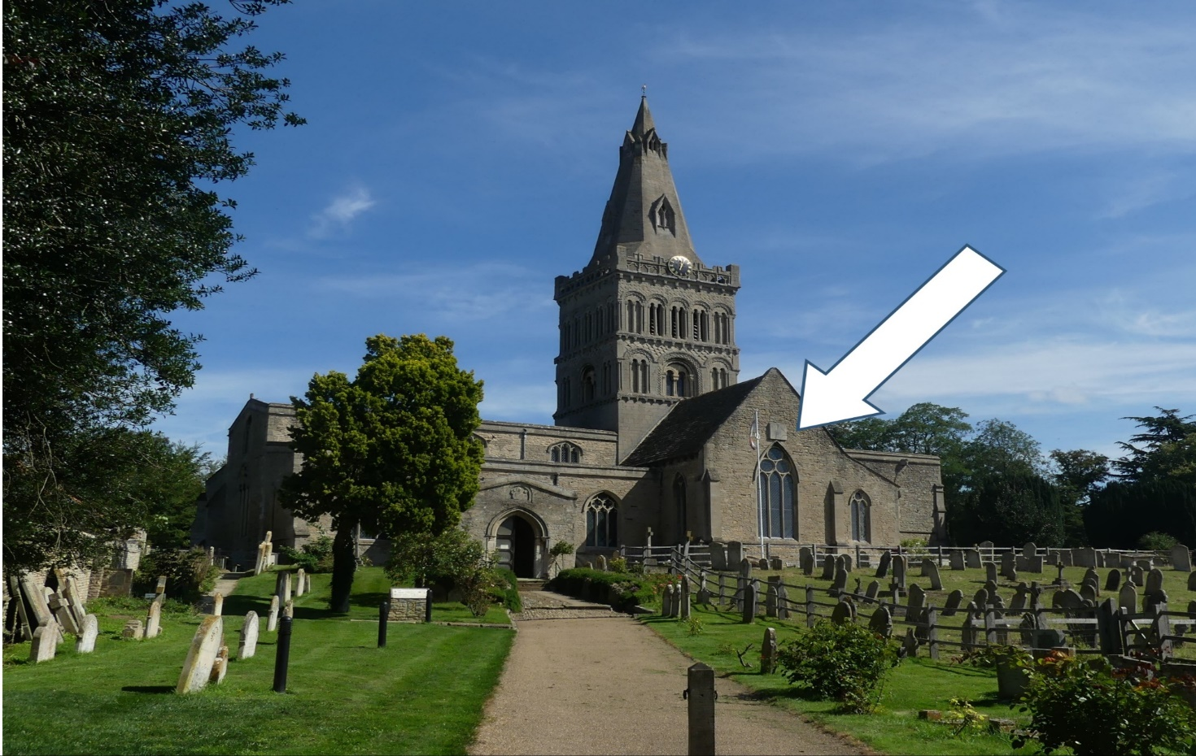
Click on the name of the area where the arrow is pointing
a) North transept
b) South transept
Great!
c) Porch
Next >>

Slide 9
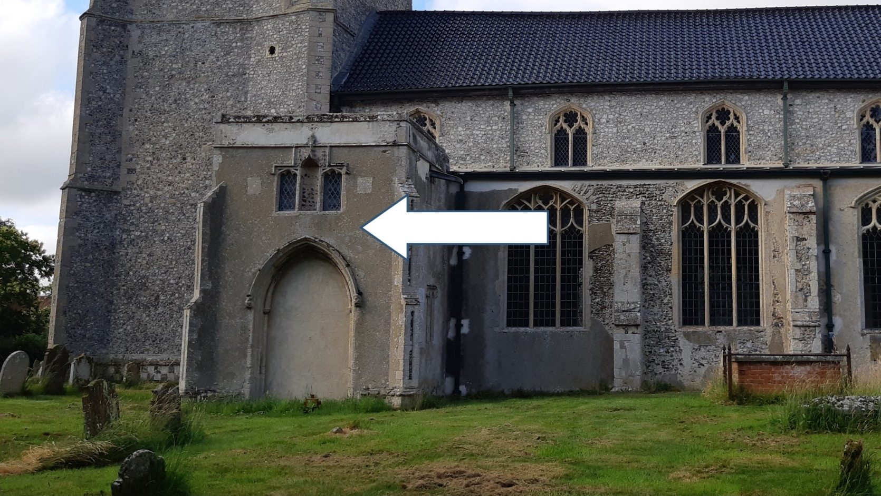
Which part of the church is this?
a) Porch
Perfect
b) South transept
c) North transept
This one is tricky as the door has been blocked off.
End>>

Slide 10
How did you do?
We hope you’re more familiar with the layout of a church

